Slide 1

Business Case Study and Report
ATLIQ HARDWARE
ATLIQ HARDWARE
Presented by:
Abhinav Singh
Date Presented:
March 5,2023

Slide 2
Problem
Statement
The Management of Atliq Hardware do not have enough insights to make quick decisions.As a result they want hire a data analyst to analyse the sales data for the fiscal year 2020 and 2021.

Slide 3
Goal
The goal of this project:
Analyse 10 ad-hoc request to give management insights to make informed decisions using SQL .
Aditionally a Tableau Dashboard was built to analyse the sales data for the fiscal year 2020 and 2021.

Slide 4
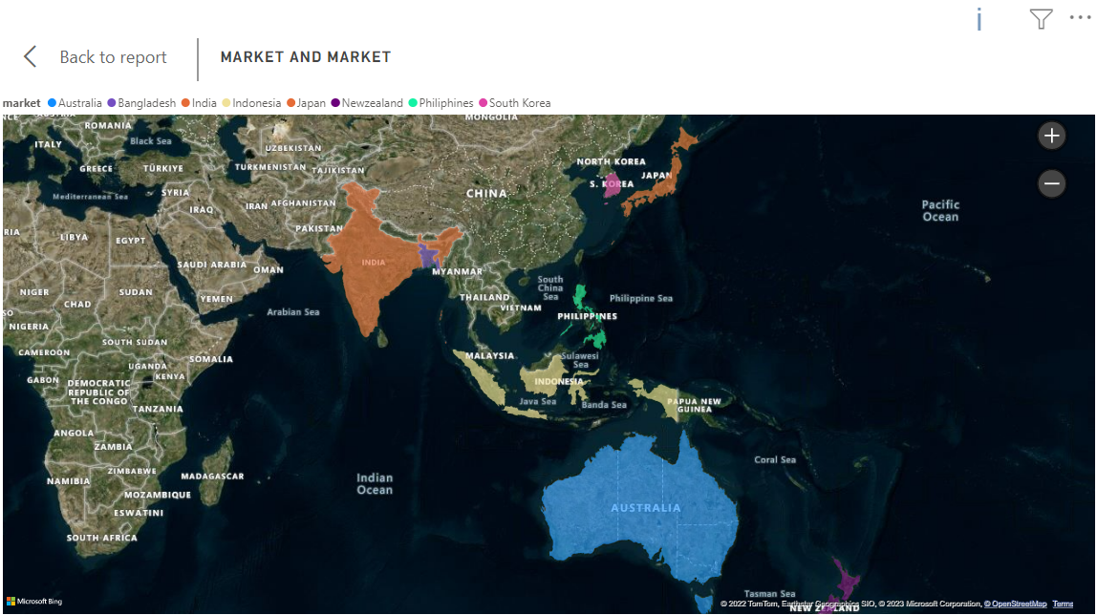
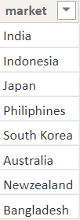
INSIGHTS
Atliq exclusive of operates in 8 markets in the APAC region
The size of the circle represents the size of the market base on sales

Slide 5
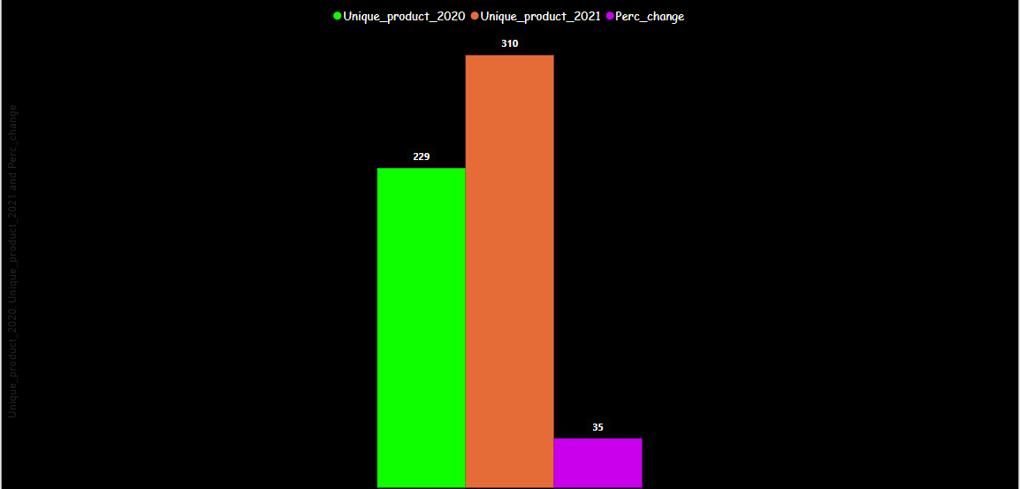
Unique products
Between fiscal year 2021 and 2020 89 new products where introduced
representing 35% in increase in unique products.

Slide 6
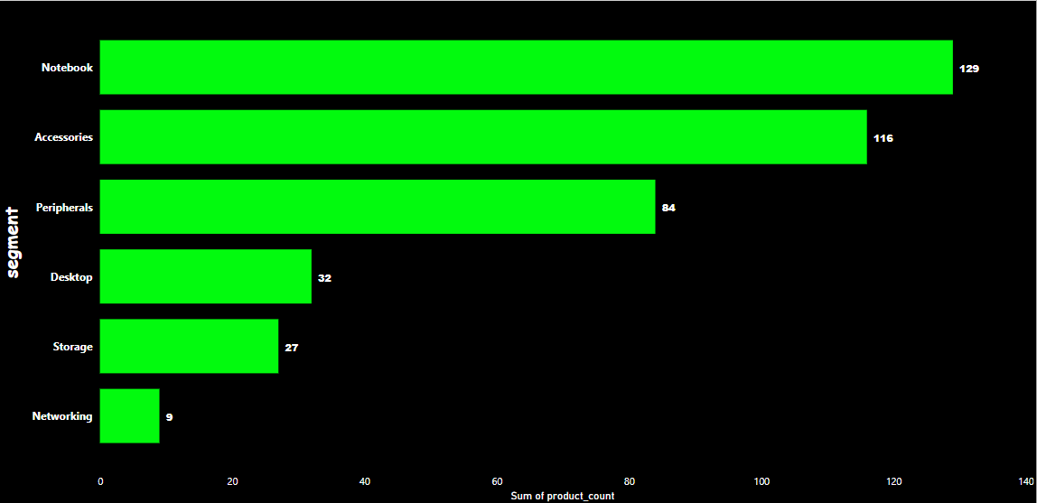
Unique product counts for each segment
Storage 27
Atliq Hardware are having competitive advantage by introducing new products which are the main driver of its revenue.
Desktop 32
Notebook 129
Notebook had the highest number of unique products that is 129 followed by Accessories which has the highest unique products and
Peripherals 84
Networking has the least unique products
Accessories 116

Slide 7
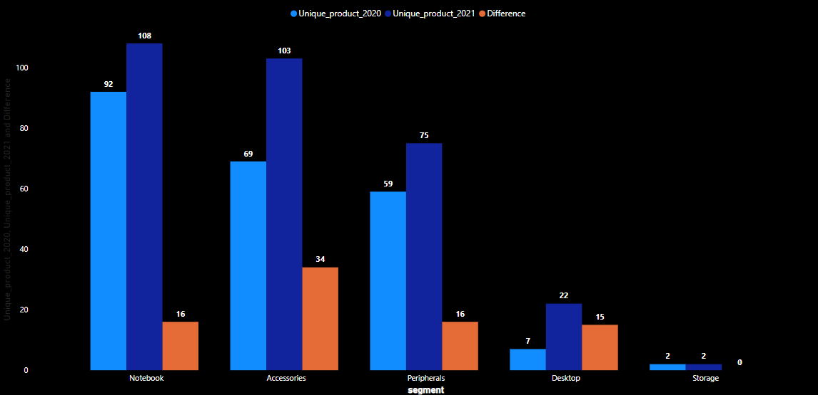
most increase in unique products in 2021 vs 2020?
Storage 27
Accessories has the highest increase in the
Unique products. It has increased from 69 to
103, thus making the difference of 34.
Desktop 32
Notebook 129
Storage is not showing any increment in 2021.
Peripherals 84
Accessories 116

Slide 8

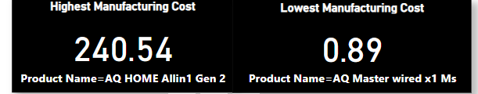

Products that have the highest and lowest manufacturing costs

Slide 9
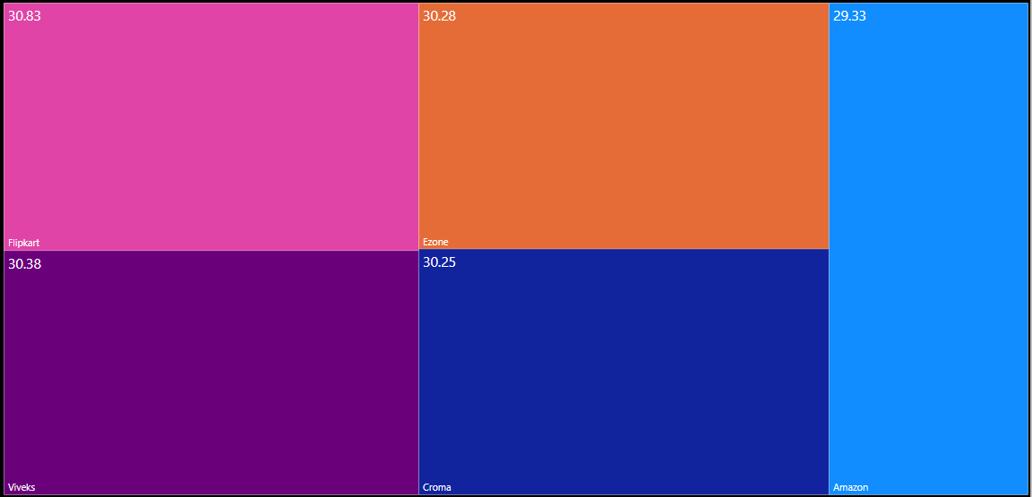
Average Pre-Discount %
Even though Amazon received the least average pre distount percentage it was the number customer of Aliq with a purchase of ₹224.3 million

Slide 10
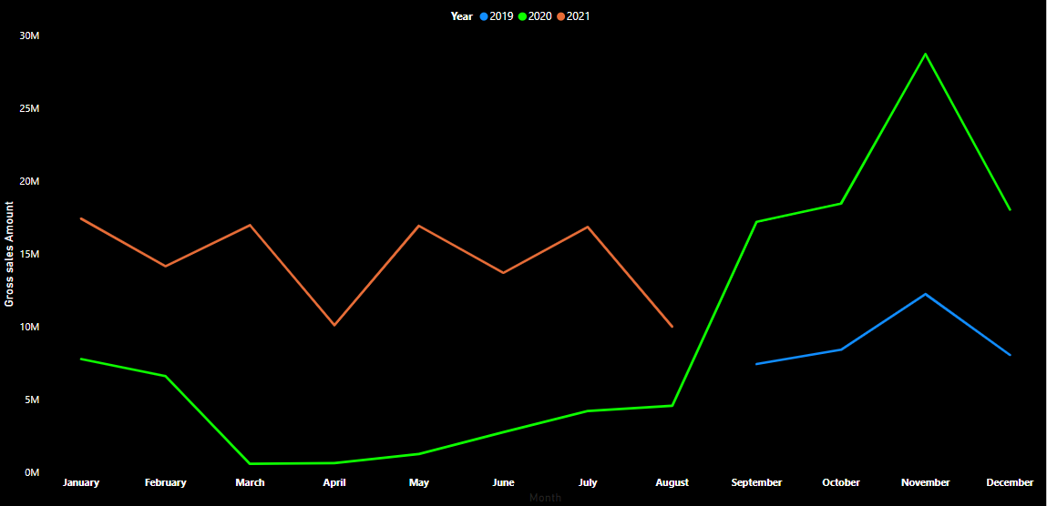
complete report of the Gross sales amount for the customer “AtliqExclusive” for each month.
High-performing months for 2021 and 2020 fiscal year was in November
Low-performing months for 2021 and 2020 fiscal year was in August and March respectively
2020 Fiscal Year

Slide 11
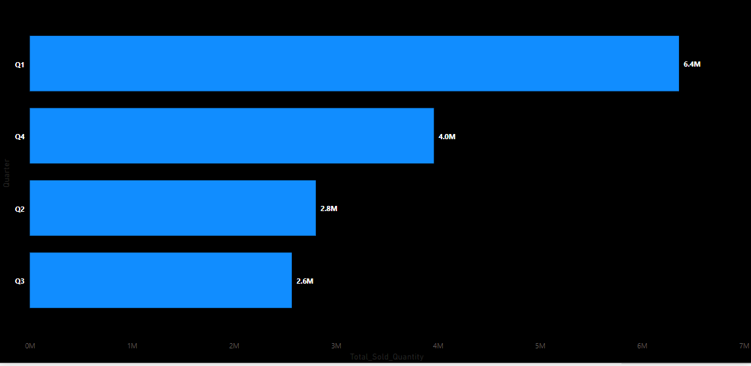
Total Quantity sold by Quarter First quarter had the highest total quantity sold
.

Slide 12
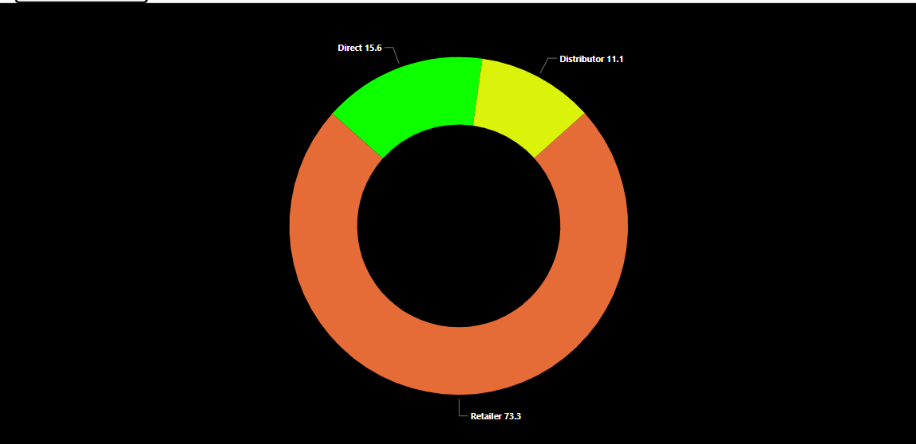
Channel contribution to Gross sales
Retailer is the highest contributor to gross sales of Atliq hardware both in the 2021 and 2020 fiscal years. Amazon is its top customer in retail outlets.

Slide 13
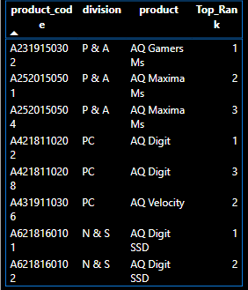
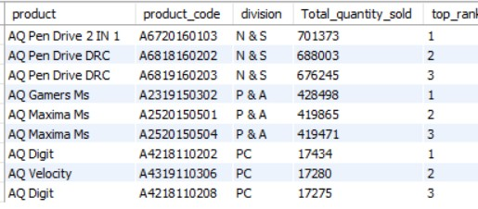
Top 3 products in each division

